Slide 1

NYCT Bus Analysis Project
Optimizing Urban Transit with IoT and Advanced Data Analytics
Daniel Premysler
Notes:
Good [morning/afternoon], everyone. I'm thrilled to share with you a project that I’ve been working on as part of our data engineering course. This project is a practical application of the concepts we've been learning, focused on using IoT data to enhance urban transit systems.
In this project, I've simulated the role of a data engineer working with IoT devices installed on buses in New York City. The goal was to collect real-time data, integrate it with static GTFS data provided by the MTA, and analyze the performance of bus routes across Manhattan.
Through this presentation, I’ll take you through the data pipeline I’ve developed, the challenges I encountered, and how I applied the tools and techniques we've studied to solve real-world problems. By the end, I hope to demonstrate how the skills we've gained can be used to create impactful solutions in urban transit and beyond

Slide 2
Agenda
Introduction and Project goals
Solution Architecture
Source
Data Ingestion
Storage
Transformation and Data Modeling
Orchestration
Demo
CI/CD
Notes:
Here’s the agenda for today’s presentation. I’ll start with an introduction and the project goals, then walk you through the solution architecture. We’ll discuss the data sources, ingestion process, storage solutions, and data modeling techniques. I’ll also cover the orchestration and CI/CD strategies we implemented before wrapping up with a demo and some security considerations.

Slide 3

Introduction and Project goals
Real-Time Data Integration: Merge live bus data (REST Api) with GTFS
Trip Reconstruction: Rebuild trips using combined datasets
Pipeline Development: Develop efficient, scalable data pipeline, hosted on the cloud
CI/CD Implementation: Streamline secure deployment and updates
Business Questions: Answer key business questions using comprehensive data analysis
Notes:
The objective of this project is to analyze NYC MTA bus route performance by integrating real-time data from IoT devices with GTFS data. The key goals are to enable real-time data integration, rebuild trips from combined datasets, develop a scalable data pipeline, and implement CI/CD for smooth deployment. Additionally, I aimed to answer critical business questions such as identifying delayed or overcrowded routes.

Slide 4
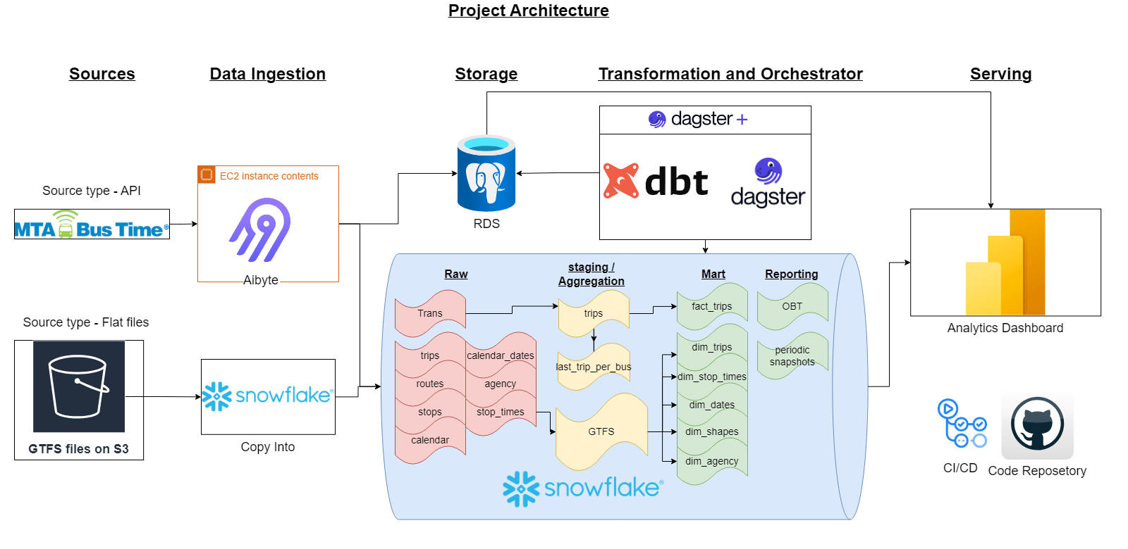
Notes:
This is the overall architecture of the solution. It begins with data collection from IoT devices and the MTA's static data. This data is then ingested into our system, processed, and stored in a scalable cloud environment. The architecture supports the transformation, modeling, and analysis of the data, allowing us to extract meaningful insights into bus route performance

Slide 5

Sources
MTA Real Bus Time API
Provides real-time bus location data
Updates every 15 seconds
MTA GTFS Static Data
Includes information on agency, calendar, routes, shapes, stop times, trips, and stops
Describes bus scheduling in New York City
Static data
Visual representation of GTFS data relationship
Notes:
"For this project, I used two main data sources: the MTA Real Bus Time API, which provides real-time location data every 15 seconds, and the MTA GTFS static data, which includes schedules, routes, and stops. The combination of these sources allows us to analyze bus routes with a high level of detail."

Slide 6
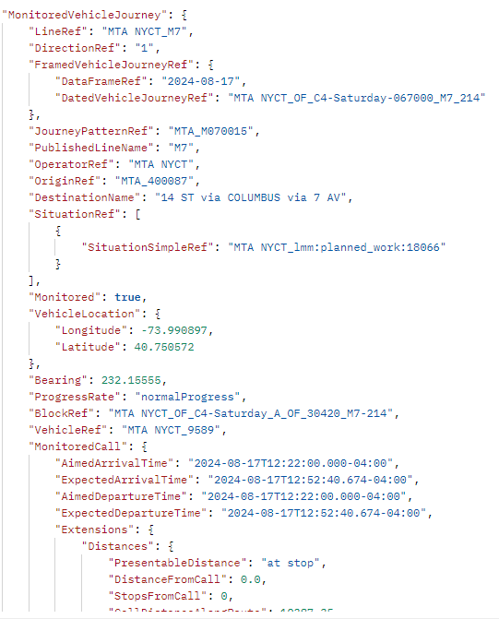
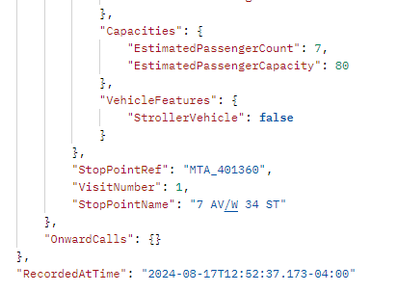
Sources
Sources
MTA Real Bus Time API
Provides real-time bus location data
Updates every 15 seconds
MTA GTFS Static Data
Includes information on agency, calendar, routes, shapes, stop times, trips, and stops
Describes bus scheduling in New York City
Static data
Visual representation of GTFS data relationship
Notes:
The MTA uses two main data sources: the Real Bus Time API for real-time bus locations and GTFS static data for bus schedules. The GTFS data includes various elements like routes and stops. More details can be found on Google Transit and MTA Developer resources. Original Content: Source The source includes the MTA real Bus Time API, which provides real-time bus location data. The API is documented here. The second source is the MTA GTFS static data, which includes information on: • Agency • Calendar • Calendar_dates • Routes • Shapes • Stop_times • Trips • Stops This data describes the scheduling of buses in New York City. The GTFS entity relationship diagram is shown below. docs/images/GTFS-entity-relationship-diagram.png Figure 2: GTFS Entity Relationship Diagram More information about GTFS data sets can be found at: Google Transit MTA Developer resources

Slide 7
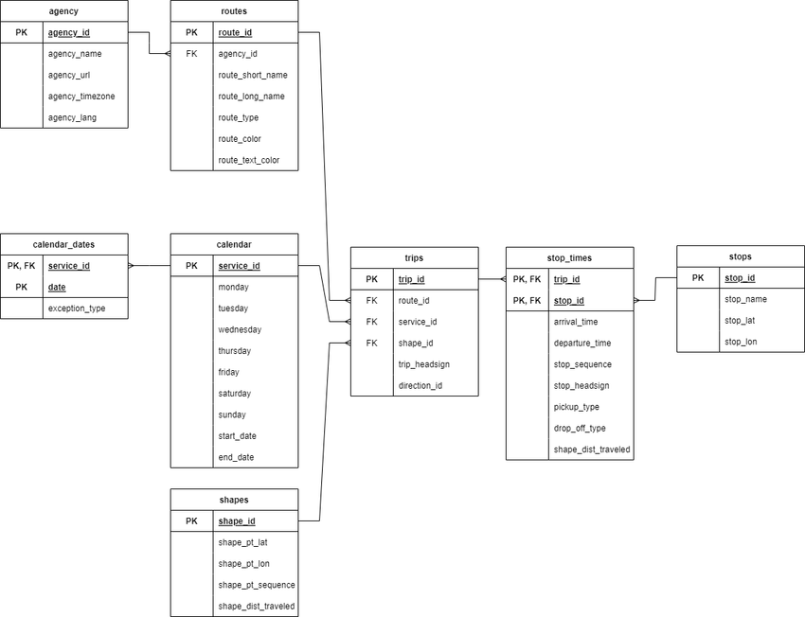
Sources
Sources
MTA Real Bus Time API
Provides real-time bus location data
Updates every 15 seconds
MTA GTFS Static Data
Includes information on agency, calendar, routes, shapes, stop times, trips, and stops
Describes bus scheduling in New York City
Static data
Visual representation of GTFS data relationship
Notes:
The MTA uses two main data sources: the Real Bus Time API for real-time bus locations and GTFS static data for bus schedules. The GTFS data includes various elements like routes and stops. More details can be found on Google Transit and MTA Developer resources. Original Content: Source The source includes the MTA real Bus Time API, which provides real-time bus location data. The API is documented here. The second source is the MTA GTFS static data, which includes information on: • Agency • Calendar • Calendar_dates • Routes • Shapes • Stop_times • Trips • Stops This data describes the scheduling of buses in New York City. The GTFS entity relationship diagram is shown below. docs/images/GTFS-entity-relationship-diagram.png Figure 2: GTFS Entity Relationship Diagram More information about GTFS data sets can be found at: Google Transit MTA Developer resources

Slide 8
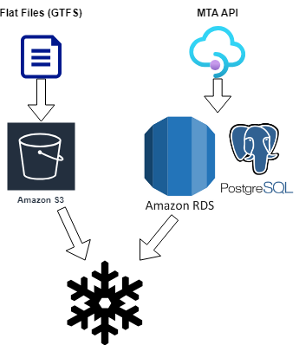
Data Ingestion
Data Ingestion with Airbyte
Hosted on Amazon EC2 instance, whitelist specific IP’s
Extracts data from MTA real Bus Time API using custom connector
Incremental load method, into Postgres RDS to avoid expensive ingestion into Snowflake
Custom Connector for API
Securely passes API key
Allows controlling size of data
Data Movement to Snowflake
Daily transfer from PostgreSQL to Snowflake using Dagster
Loading GTFS Files
Hosted on S3 bucket
Ingested using Snowflake’s COPY INTO method
Efficiently handles large files
Notes:
The data ingestion process is managed by Airbyte, hosted on an Amazon EC2 instance. It extracts data from the MTA Real Bus Time API using a custom connector and loads it into PostgreSQL. From there, the data is transferred daily to Snowflake using Dagster. GTFS files are hosted on S3 and ingested into Snowflake using the COPY INTO method, which efficiently handles large files

Slide 9


Storage
Snowflake as Main Storage
Scalability: Easily handles large data volumes
Performance: Excellent query performance with columnar storage and MPP engine
Efficient data loading: Quick loading with COPY INTO method
Built-in features: Time travel and data sharing for analysis and collaboration
Integration with BI tools: Works well with many BI vendors
PostgreSQL for Raw Transit Data
Cost-effective buffer: Avoids high costs of frequent Snowflake queries
Near real-time reporting: Immediate insights into bus locations
Data staging: Allows for initial data quality checks and preprocessing
Notes:
For storage, I used Snowflake for its scalability and performance. It’s well-suited for handling large data volumes and integrates seamlessly with BI tools like PowerBI. PostgreSQL is used as a cost-effective buffer for raw transit data, allowing for near real-time reporting and data staging before the data is transferred to Snowflake.

Slide 10
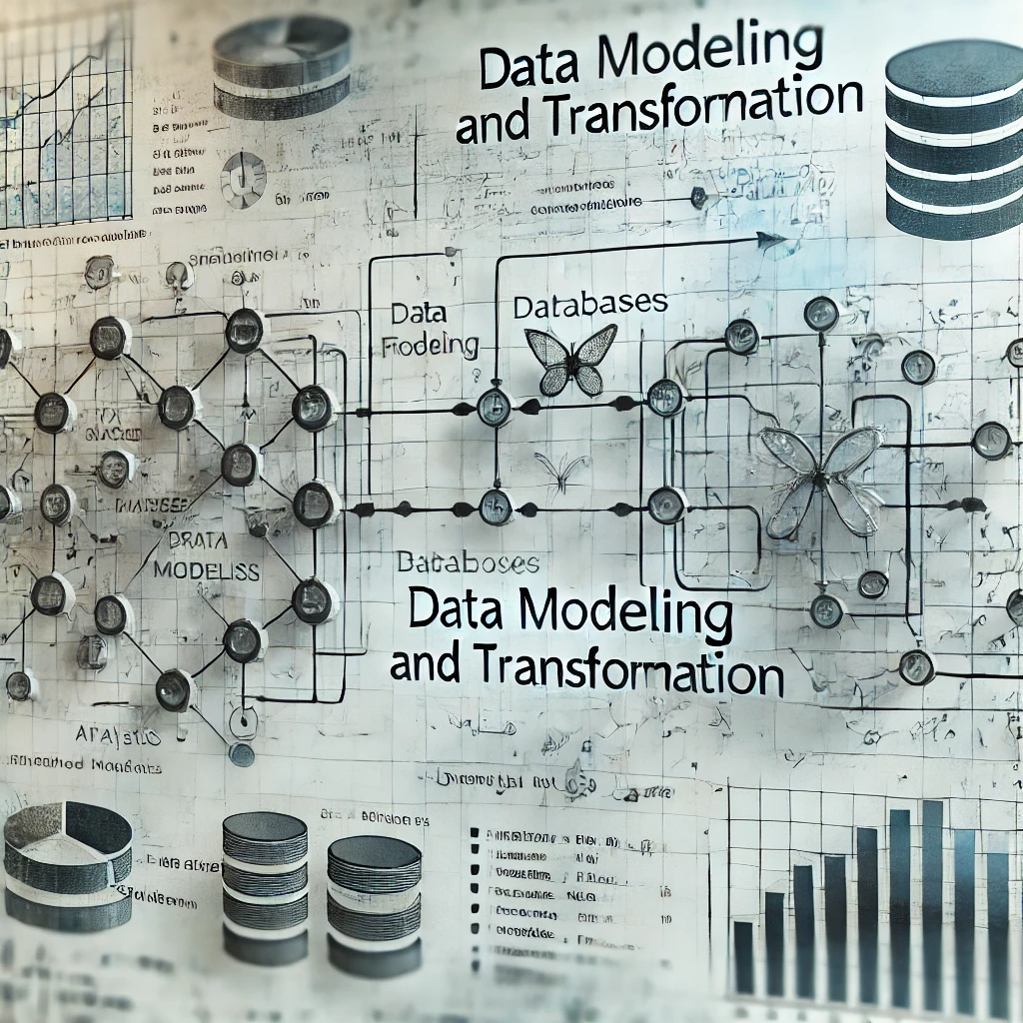
Transformation and Data Modeling
Data modeling with dbt
Field rename
Data type casting
Case statements
Concatenation
Date formatting
Data aggregation
Enrichment with GTFS data
Trip identification
Data Quality Checks with great expectations for dbt
Notes:
In this phase, the data undergoes various transformations. We start with field renaming, data type casting, and other basic transformations. Then, the transit data is aggregated and enriched with GTFS data to create detailed trip records. Data quality checks are performed using Great Expectations and dbt to ensure the integrity of the data before it's moved to the final marts schema

Slide 11
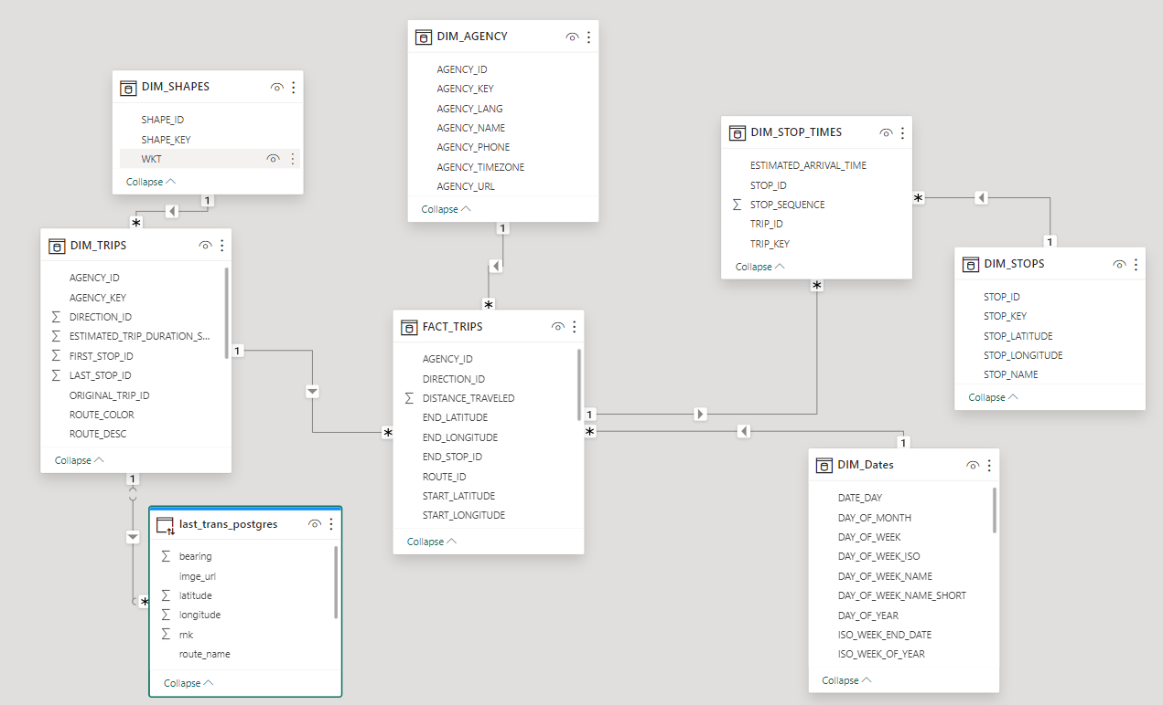
Data modeling ERD
Notes:
The transformation process involves field renaming, data type casting, and more. Trans data is converted into trips through aggregation, enrichment, and validation. Data quality checks ensure integrity, and the marts schema is created with additional transformations. Original Content: Transformation and Data Modeling The data loaded from Airbyte and S3 into Snowflake forms the raw schema. This data is then read and undergoes various transformations before forming the staging schema: • Field rename • Data type casting • case statements • concatenation • date formatting Converting trans data into trips The process of converting the trans data into trips involves several key steps: 1. Data aggregation: The raw transit data from trans.sql is aggregated to create meaningful trip records. This likely involves grouping the data by vehicle, route, and time periods to identify distinct trips. 2. Enrichment with GTFS data: The aggregated transit data is combined with static GTFS data (routes, stops, schedules) to add context and additional information to each trip. 3. Trip identification: Algorithms are applied to determine the start and end of each trip, possibly using factors like time thresholds, route changes, or specific stop patterns. 4. Calculation of metrics: Various performance metrics are calculated for each trip, such as actual travel time, scheduled travel time, delays, and potentially crowding information. 5. Data cleaning and validation: The process includes steps to clean the data, handle anomalies, and ensure the quality and consistency of the trip records. 6 Incremental approach: Post creation of trips a post hook is triggered to create a table with the latest trip date per each vehicle. Ensuring the next run would continute per each vehicle from the latest trans data available. Meaning even if a bus havent sent new data for days the incremental process would try to continue searching for new data. This transformation process takes the granular, real-time data and converts it into a higher-level, trip-based format, that’s more suitable for route performance analysis and reporting. Before the data is loaded into the staging schema, data quality checks were performed using Great Expectations and dbt tests, ensuring that: • Primary keys and foreign keys are not null • Referential integrity between related tables • Accepted value tests, confirming that certain columns only contain predefined acceptable values • validating relationships between different models Lastly, the marts schema is created performing additional transformations such as joins, aggregations,calculations, and surrogate keys. The marts schema can be represented by the following Entity Relationship Diagram (ERD): docs/images/ERD.png Figure 5: Marts - Entity Relationship Diagram (ERD)

Slide 12

Orchestration
Dagster as Orchestration Tool
Deployed using Dagster Cloud
CD with separate brunch deployment and prod deployement
Asset-based orchestration approach
Considered Materialization Approaches
Dagster Asset Job
Dagster Auto-materialize assets
Chosen Approach – Asset job
More flexible and customizable
Battle tested
Dagster Responsibilities
Calling Airbyte connection
Executing Snowflake COPY INTO
Executing dbt
Notes:
For orchestration, I used Dagster, which was deployed via Dagster Cloud. After considering different orchestration approaches, I opted for Dagster Asset Job because of its flexibility and customization options. Dagster is responsible for managing the entire workflow, from Airbyte connections to Snowflake data loading and dbt workflows.

Slide 13
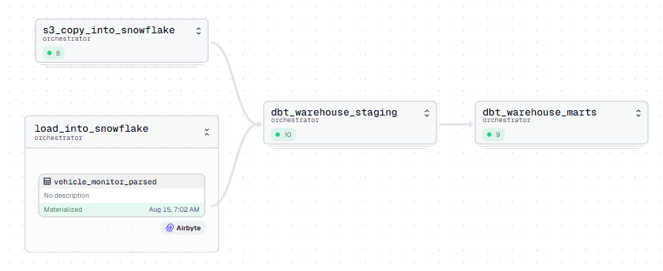
Orchestration - Asset job diagram
Notes:
Now I’d like to show you a live demonstration of the project in action. I’ll walk you through the entire process, from data ingestion to transformation and finally to visualization. You’ll see how the pipeline processes real-time bus location data and produces actionable insights through our dashboard.

Slide 14

CI/CD
Linter
Flags improperly formatted SQL and Python code.
Branch Deployment
Creates staging environments for Dagster code
Triggers on every pull request
Allows real-time preview of branch changes
Prod Deployment
Deploys to Dagster Cloud on main branch push
Ensures production environment is updated seamlessly via serverless deployment
Notes:
To ensure smooth deployment, I implemented a CI/CD pipeline. Linter is used to flag improperly formatted SQL and Python code. Branch deployment is set up for staging environments, allowing real-time preview of changes. Finally, production deployment is triggered on main branch pushes, ensuring the production environment is always up-to-date.

Slide 15
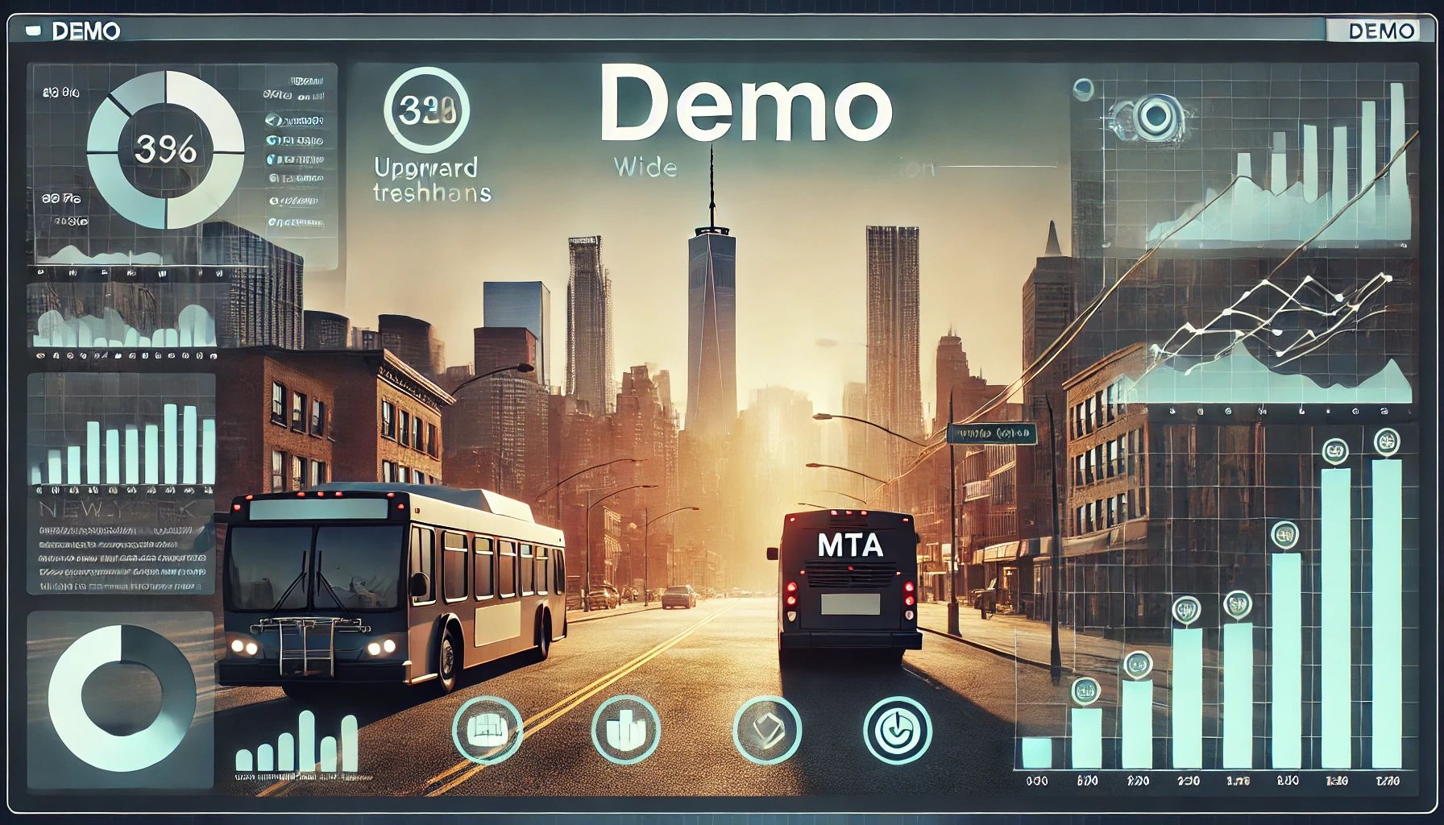

Slide 16

Getting started / instructions
Infrastructure: Configurable Terraform code to start the project
Airbyte: Custom connector for the API
Instructions: Available at the project repo
Demo
Notes:
For anyone looking to replicate this project, I’ve provided detailed instructions in the project repository. The infrastructure is configured using Terraform, and there’s a custom connector for the API. The instructions will guide you through setting up Airbyte, getting GTFS data, testing the pipeline, and deploying it.

